Slide 1
UNIT 2
Machine Learning

Slide 2
Machine Learning
In the past 50 years, there has been an explosion of data, this mass of data is useless unless we analyse it and find the patterns hidden within.
Machine Learning is undeniably one of the most influential and powerful technologies in today’s world.
Machine learning is a tool for turning information into knowledge.
Machine learning techniques are used to automatically find the valuable underlying patterns within complex data that we would otherwise struggle to discover.
The hidden patterns and knowledge about a problem can be used to predict future events and perform all kinds of complex decision making.

Slide 3
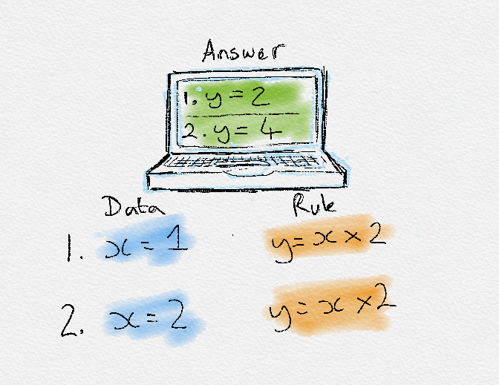
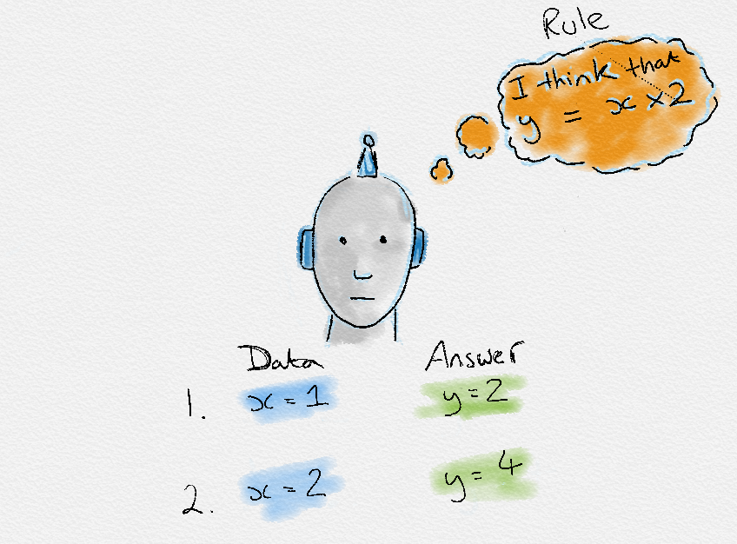
Traditional System Vs Machine Learning

Slide 4
Definitions
Machine Learning was coined by Arthur Samuel in 1959, “it gives computers the ability to learn without being explicitly programmed”.
In 1997, Tom Mitchell gave a “well-posed” mathematical and relational definition that “A computer program is said to learn from experience E with respect to some task T and some performance measure P, if its performance on T, as measured by P, improves with experience E.
Machine Learning
Study of algorithms that
improve their performance
at some task
with experience

Slide 5
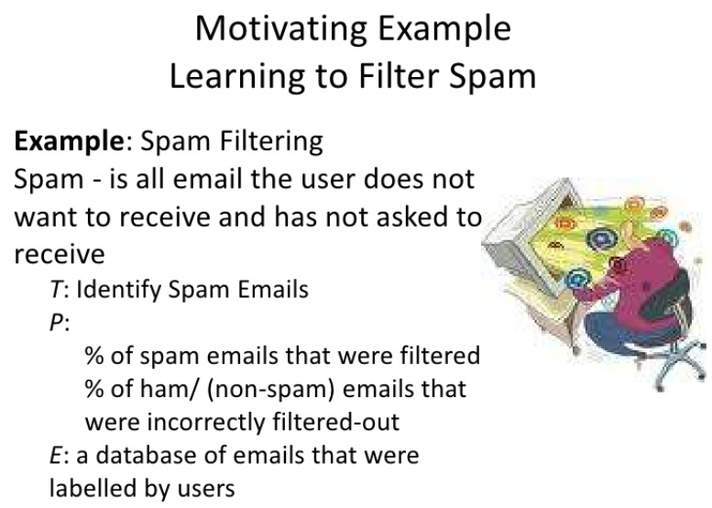

Slide 6
Machine Learning Applications
Every time we Google something, listen to a song or even take a photo, Machine Learning is becoming part of the engine behind it, constantly learning and improving from every interaction.
It’s also behind world-changing advances like detecting cancer, creating new drugs and self-driving cars.
Speech recognition, Natural language processing
Computer vision
Medical outcomes analysis
Robot control
Computational biology

Slide 7
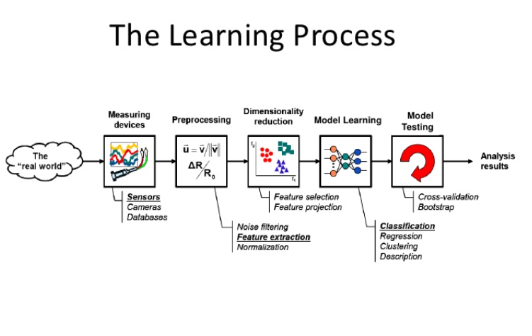

Slide 8
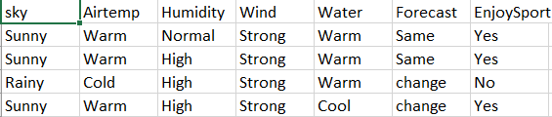
Terminology
Dataset: A set of data examples, that contain features important to solving the problem.
Features: Important pieces of data that help us understand a problem. These are fed in to a Machine Learning algorithm to help it learn.
Model: The representation of a phenomenon that a Machine Learning algorithm has learnt. It learns this from the data it is shown during training. The model is the output you get after training an algorithm. For example, a decision tree algorithm would be trained and produce a decision tree model.

Slide 9
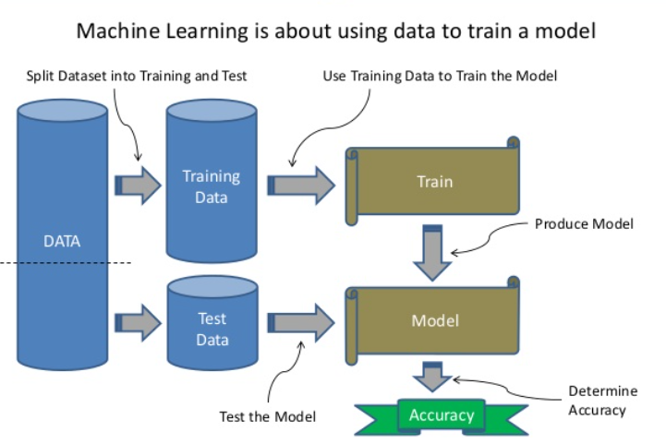
Splitting DataSets
To use dataset in machine learning the dataset is first split into a training and test set.
The training set is used to train the model
The test set is used to test the accuracy of the model

Slide 10
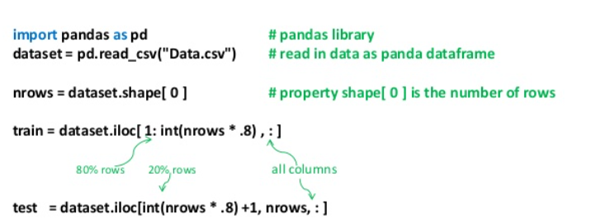
Splitting of Dataset
Method 1

Slide 11
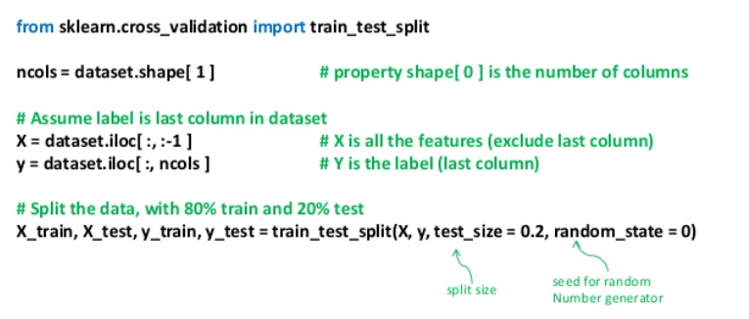
Second Method

Slide 12
Data Imbalance _Overfitting
If the training data is overly unbalanced, then the model will predict a non meaningful result
For example, if a model is a binary classifier (eg. Cat vs Dog) and nearly all the samples are of the same label (cat) then the model will simply learn that everything is a that label (Cat).
This is called Overfitting. To prevent overfitting, there needs to be fairly equal distribution of training samples for each classification, or range if label is a real value

Slide 13
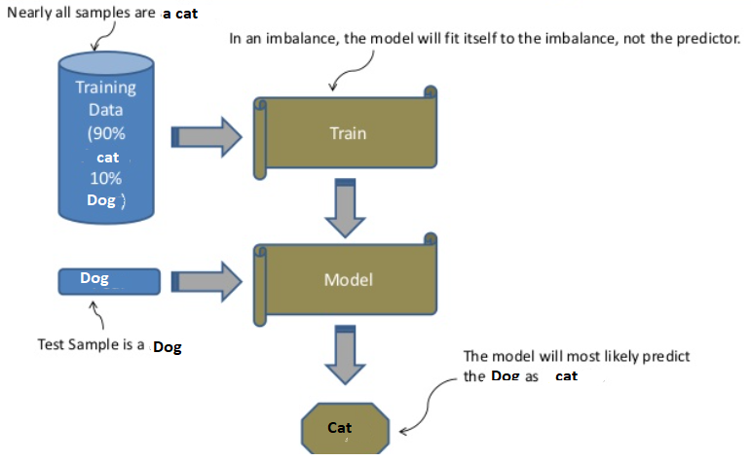

Slide 14
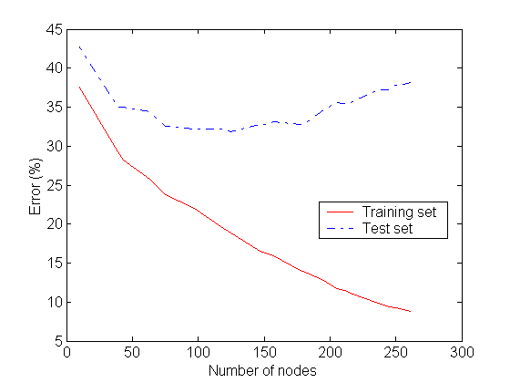
Complexity of a Decision
Tree := number of nodes
It uses
Underfitting: when model is too simple, both training and test errors are large
Overfitting: when model is too complex and test errors are large although training errors are small.

Slide 15
Type of models
Supervised learning
Given access to classified data
Learn to predict output when given an input vector
Learn an unknown function f(X) = Y, where X is an input example and Y is the desired output.
Unsupervised learning
Given access to data, but no classification
Create an internal representation of the input e.g. form clusters; extract features
Important for data reduction
Reinforcement learning
Selects actions and observes consequences.
Learn action to maximize payoff
Maximizes long-term cumulative return.

Slide 16
Supervised concept learning
Given a training set of positive and negative examples of a concept
Construct a description that will accurately classify whether future examples are positive or negative
That is, learn some good estimate of function f given a training set {(x₁, y₁), (x₂, y₂), ..., (x_{n}, y_{n})} where each y_{i} is either + (positive) or - (negative), or a probability distribution over +/-
16

Slide 17
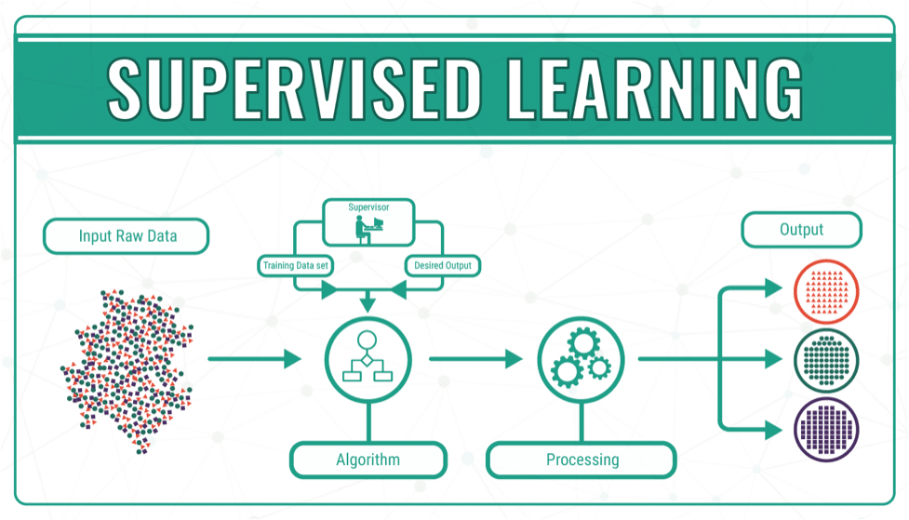

Slide 18
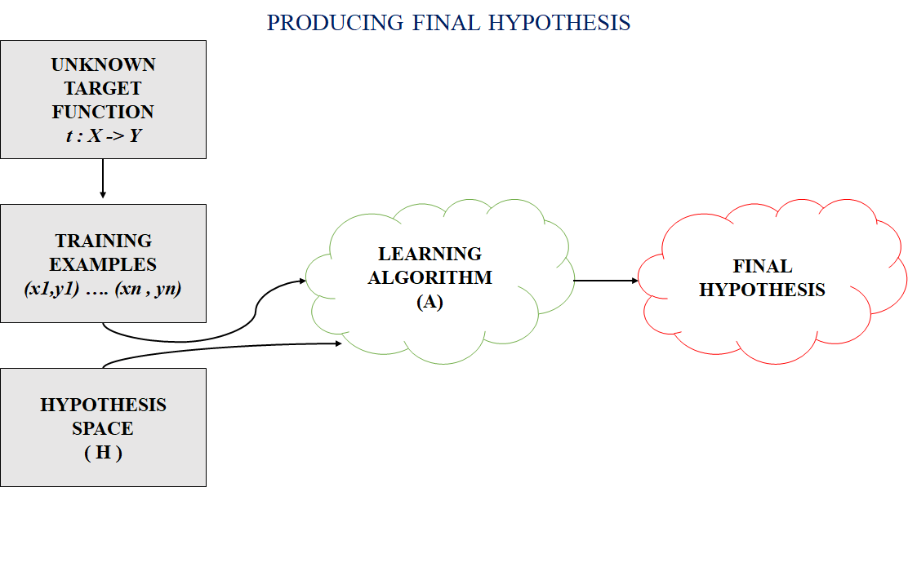

Slide 19
Hypothesis Space
One way to think about a supervised learning machine is as a device that explores a “hypothesis space”.
Each setting of the parameters in the machine is a different hypothesis about the function that maps input vectors to output vectors.
If the data is noise-free, each training example rules out a region of hypothesis space.
If the data is noisy, each training example scales the posterior probability of each point in the hypothesis space in proportion to how likely the training example is given that hypothesis.
The art of supervised machine learning is in:
Deciding how to represent the inputs and outputs
Selecting a hypothesis space that is powerful enough to represent the relationship between inputs and outputs but simple enough to be searched.

Slide 20
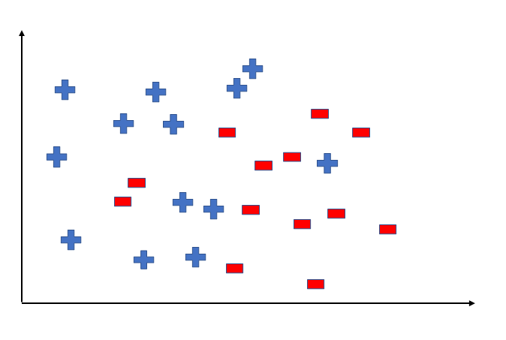
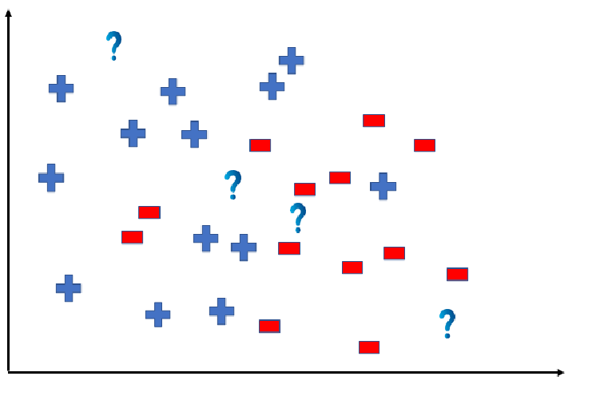
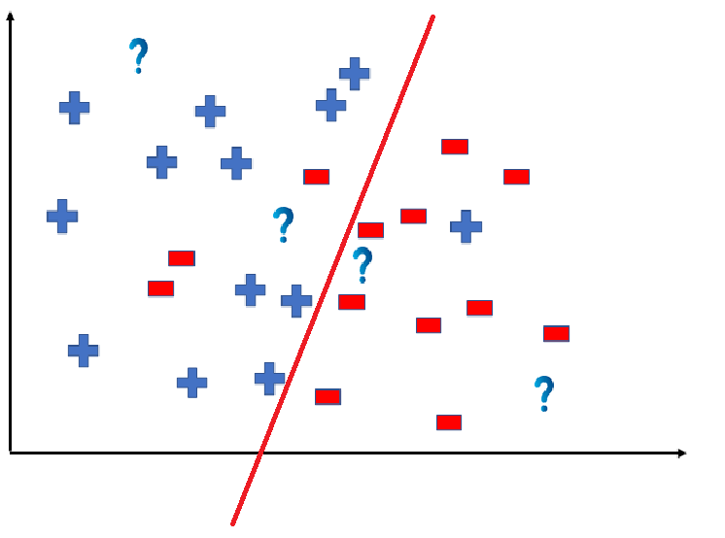
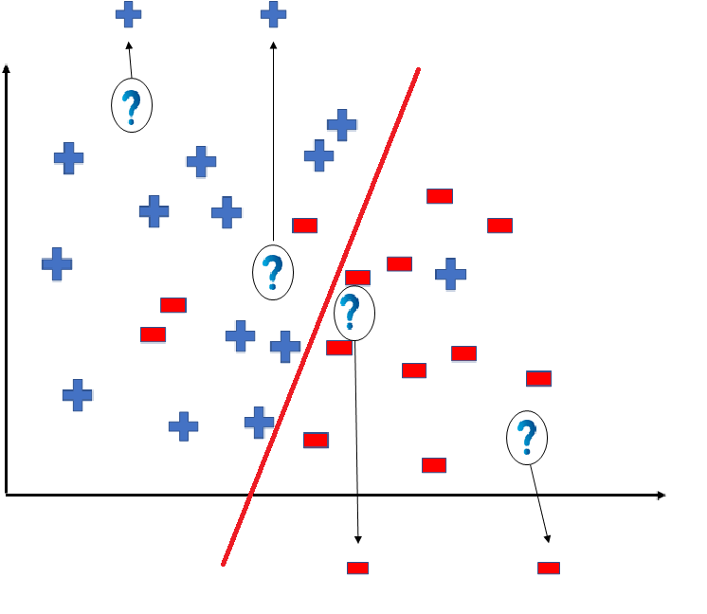
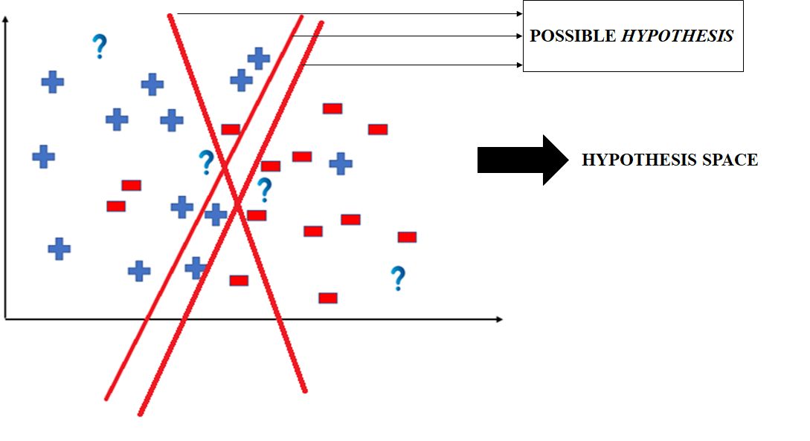

Slide 21
Searching a hypothesis space
The obvious method is to first formulate a loss function and then adjust the parameters to minimize the loss function.
This allows the optimization to be separated from the objective function that is being optimized.
Bayesians do not search for a single set of parameter values that do well on the loss function.
They start with a prior distribution over parameter values and use the training data to compute a posterior distribution over the whole hypothesis space.

Slide 22
Loss Functions
Squared difference between actual and target real-valued outputs.
Number of classification errors
Problematic for optimization because the derivative is not smooth.
Negative log probability assigned to the correct answer.
This is usually the right function to use.
In some cases it is the same as squared error (regression with Gaussian output noise)
In other cases it is very different (classification with discrete classes needs cross-entropy error)

Slide 23
Generalization
The real aim of supervised learning is to do well on test data that is not known during learning.
Choosing the values for the parameters that minimize the loss function on the training data is not necessarily the best policy.
We want the learning machine to model the true regularities in the data and to ignore the noise in the data.
But the learning machine does not know which regularities are real and which are accidental quirks of the particular set of training examples we happen to pick.
So how can we be sure that the machine will generalize correctly to new data?

Slide 24
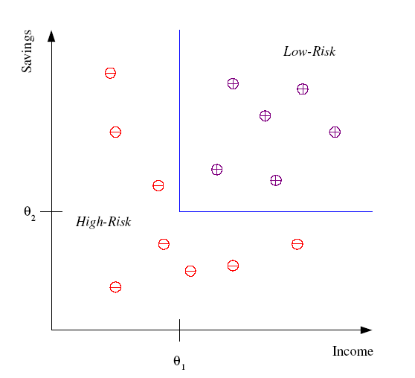
Classification
Example: Credit scoring
Differentiating between low-risk and high-risk customers from their income and savings
Discriminant: IF income > θ₁ AND savings > θ₂
THEN low-risk ELSE high-risk
Model
24

Slide 25
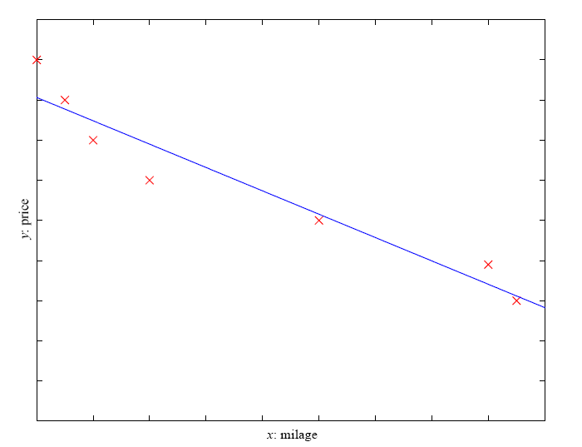
Regression
Example: Price of a used car
x : car attributes
y : price
y = g (x | θ )
g ( ) model,
θ parameters
y = wx+w₀
25

Slide 26
Unsupervised Learning
Learning useful structure without labeled classes, optimization criterion, feedback signal, or any other information beyond the raw data
Examples:
Example 1: groups people of similar sizes together to make “small”, “medium” and “large” T-Shirts.
Example 2: In marketing, segment customers according to their similarities To do targeted marketing.
Example 3: Given a collection of text documents, we want to organize them according to their content similarities, To produce a topic hierarch

Slide 27
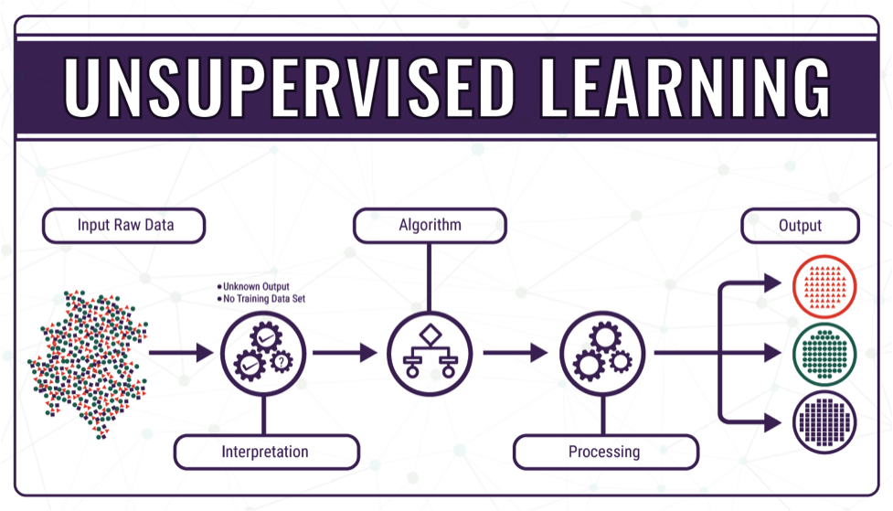

Slide 28
Clustering
Clustering is a technique for finding similarity groups in data, called clusters
Task of grouping a set of data points such that data points in the same group are more similar to each other than data points in another group (group is known as cluster).
it groups data instances that are similar to (near) each other in one cluster and data instances that are very different (far away) from each other into different clusters.
Types: 1. Exclusive Clustering: K-means
2. Overlapping Clustering: Fuzzy C-means
3. Hierarchical Clustering: Agglomerative clustering, divisive clustering
4. Probabilistic Clustering: Mixture of Gaussian models

Slide 29
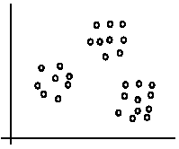
The data set has three natural groups of data points, i.e., 3 natural clusters.

Slide 30
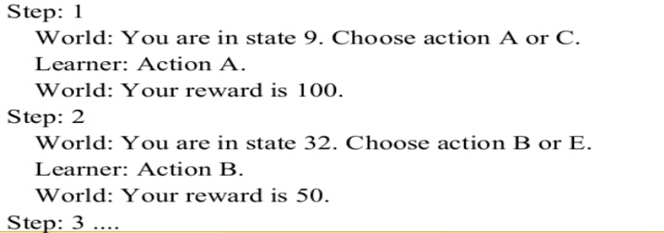
Reinforcement Learning
Close to human learning
Algorithm learns a policy of how to act in a given environment
Every action has some impact in the environment and the environment provides rewards that guides the learning algorithm.

Slide 31

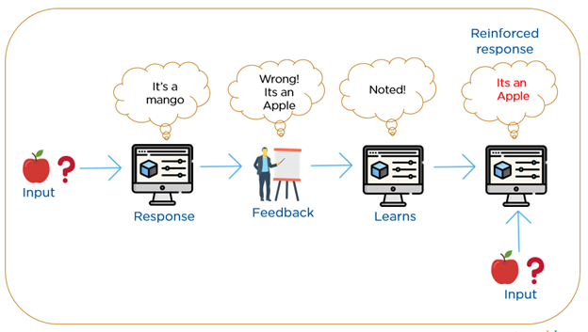

Slide 32
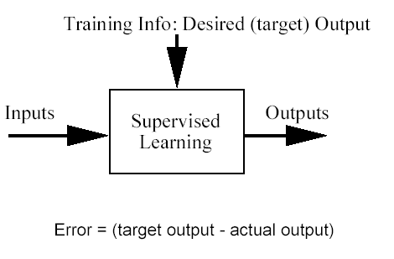
Classification problem
Training data: examples of the form (d,h(d))
where d are the data objects to classify (inputs)
and h(d) are the correct class info for d, h(d)∈{1,…K}
Goal: given d_{new}, provide h(d_{new})
Notes:
32

Slide 33
A word about the Bayesian framework
Allows us to combine observed data and prior knowledge
Provides practical learning algorithms
It is a generative (model based) approach, which offers a useful conceptual framework
This means that any kind of objects (e.g. time series, trees, etc.) can be classified, based on a probabilistic model specification
Notes:
33

Slide 34
Bayes’ Rule
Who is who in Bayes’ rule
Notes:
34

Slide 35
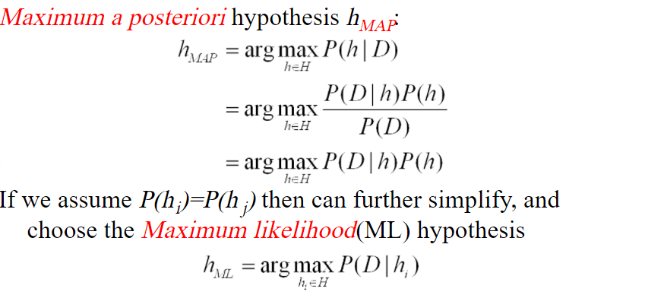

Slide 36
Introduction to bayes Theorem
Probability D₁ over and probability D₂ for
Equally likely.
Computing the probability of “smiley” given a point (x,y).
Use Bayes formula.
Let p be the probability.
(x,y)

Slide 37
Task: generate class label to a point at location (x,y)
Determine between S or H by comparing the probability of P(S|(x,y)) to P(H|(x,y)).
Clearly, one needs to know all these probabilities

Slide 38
Linear Regression
Regression is a statistical procedure that determines the equation for the straight line that best fits a specific set of data.
Simple regression analysis is a statistical tool That gives us the ability to estimate the mathematical relationship between a dependent variable (usually called y) and an independent variable (usually called x).
Any straight line can be represented by an equation of the form Y = bX + a, where b and a are constants
The value of b is called the slope constant and determines the direction and degree to which the line is tilted
The value of a is called the Y-intercept and determines the point where the line crosses the Y-axis.

Slide 39
The goal of the analyst who studies the data is to find a functional relation between the response variable y and the predictor variable x.

Slide 40
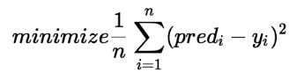
Regression Function
The statement that the relation between X and Y is statistical should be interpreted as providing the following guidelines:
1. Regard Y as a random variable.
2. For each X, take f (x) to be the expected value (i.e., mean value) of y.
3. Given that E (Y) denotes the expected value of Y, call the equation
the regression function.

Slide 41
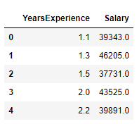
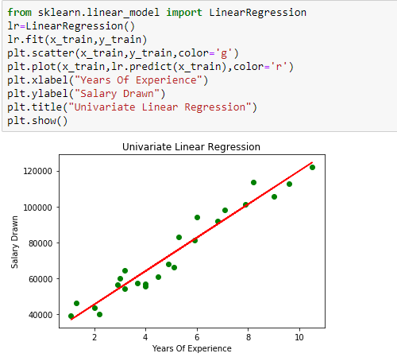

Slide 42
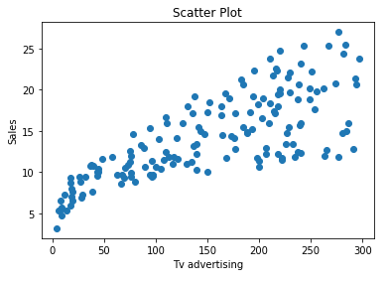
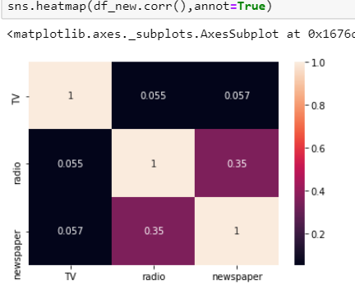
Assumptions of Linear Regression
Linear Relationship between the features and target
Little or no Multicollinearity between the features

Slide 43
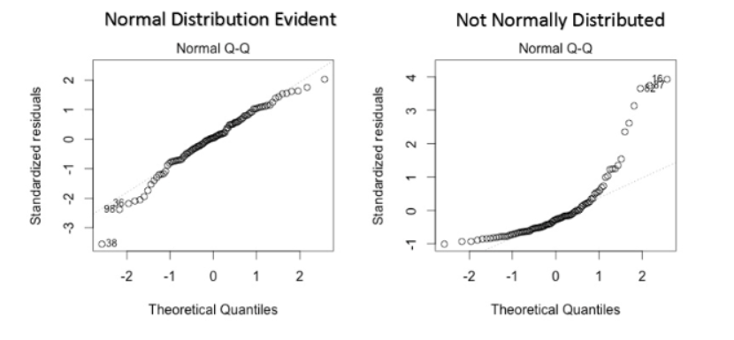
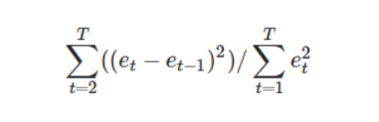
Normal distribution of error terms:
Little or No autocorrelation in the residuals

Slide 44
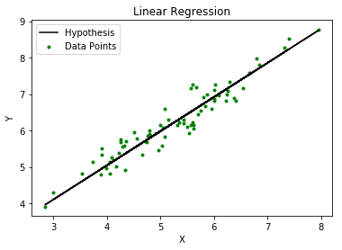
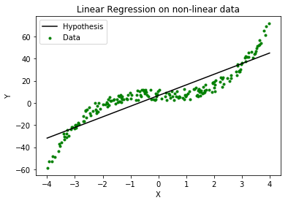
Locally weighted Regression

Slide 45
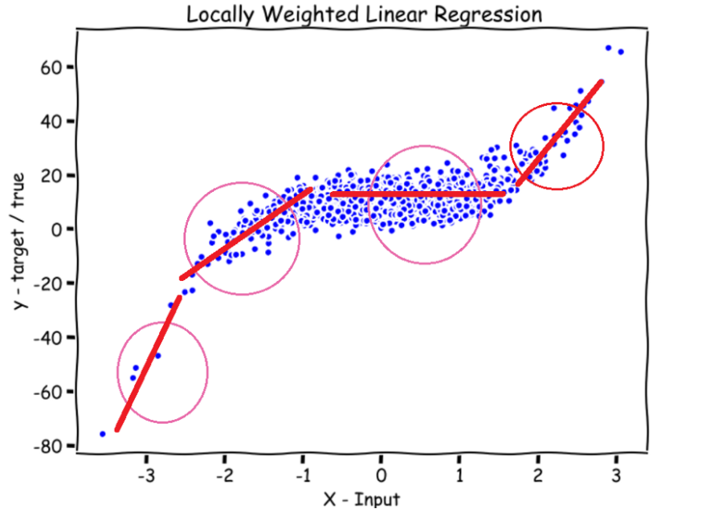

Slide 46
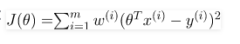
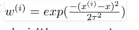
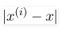
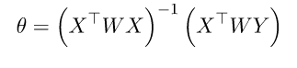
The model does not learn a fixed set of parameters as is done in ordinary linear regression.
w^{(i)} is a non negative weight
If the x^{(i)} lying closer to query point q w^{(i)} is large and lying far away having smaller w^{(i)}
^{If is small} w(i) closer to 1 else closer to 0

Slide 47
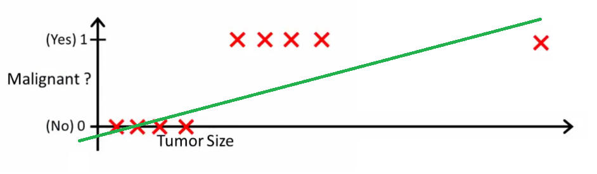
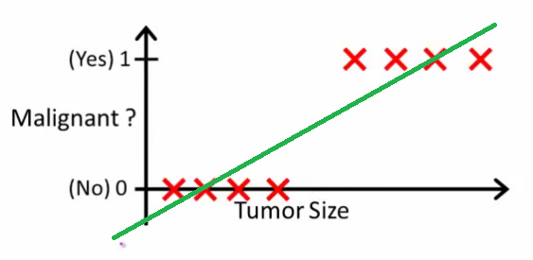
Logistic Regression
The linear regression model can work well for regression, but fails for classification.
Problem: you could label one of the classes with 0 and the other with 1 and use linear regression. it works and most linear model programs will spit out weights for you. A linear model does not output probabilities, but it treats the classes as numbers (0 and 1) and fits the best hyperplane (for a single feature, it is a line) that minimizes the distances between the points and the hyperplane.

Slide 48
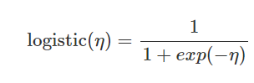
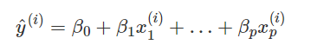
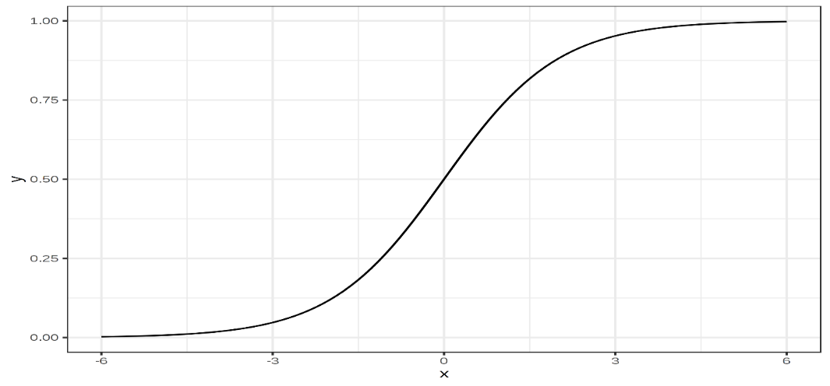
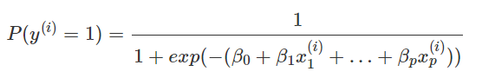
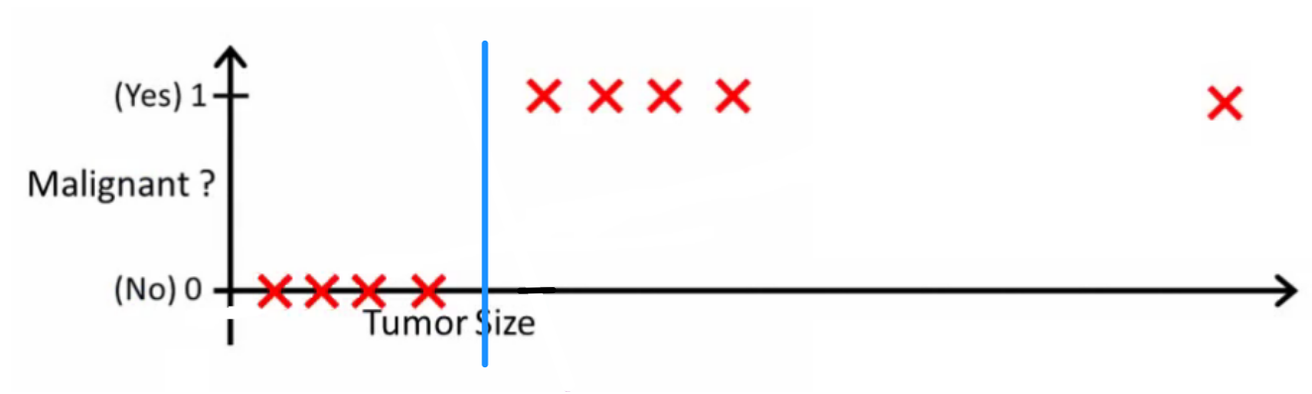
Instead of fitting a straight line or hyperplane, the logistic regression model uses the logistic function to squeeze the output of a linear equation between 0 and 1.
The logistic regression model is not only a classification model, but also gives you probabilities.
Logistic regression can also be extended from binary classification to multi-class classification. Then it is called Multinomial Regression.

Slide 49
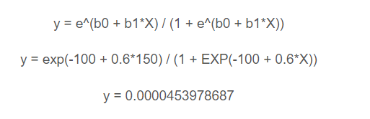
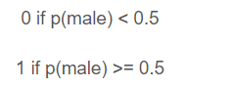
Maximum-likelihood estimation is a common learning algorithm used by a variety of machine learning algorithms, although it does make assumptions about the distribution of your data
Example: we have a model that can predict whether a person is male or female based on their height Given a height of 150cm is the person male or female.
We have learned the coefficients of b0 = -100 and b1 = 0.6. Using the equation above we can calculate the probability of male given a height of 150cm

Slide 50
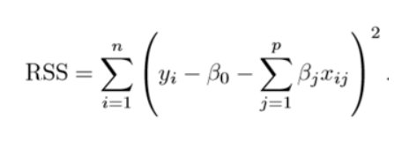
Regularization
This is a form of regression, that constrains/ regularizes or shrinks the coefficient estimates towards zero.
This technique discourages learning a more complex or flexible model, so as to avoid the risk of overfitting.

Slide 51
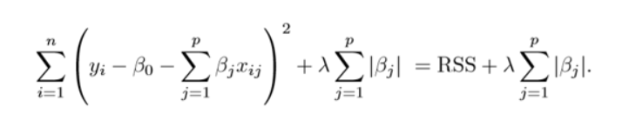
Lasso
This variation differs from ridge regression only in penalizing the high coefficients. It uses |βj|(modulus)instead of squares of β, as its penalty. In statistics, this is known as the L1 norm.

Slide 52

Ridge Regression
RSS is modified by adding the shrinkage quantity. Now, the coefficients are estimated by minimizing this function. Here, λ is the tuning parameter that decides how much we want to penalize the flexibility of our model. This is called L2 norm
The increase in flexibility of a model is represented by increase in its coefficients, and if we want to minimize the above function, then these coefficients need to be small.
This is how the Ridge regression technique prevents coefficients from rising too high.

Slide 53

Naïve Bayesian Classifier
Classifier: A classifier is a machine learning model that is used to discriminate different objects based on certain features.
It is based on Bayes Theorem
Principle: pair of features being classified in independent of each other
Naïve Bayesian Assumes that each feature is independent and equal contribution on outcome
Bayes Theorem
y is class variable and X is a dependent feature vector (of size n)

Slide 54

DataSet

Slide 55


X={x1=Outlook,x2=Temp, x3=Humidity, x4=Wind}
Y={PlayTennis}
Example:
X={Sunny, Hot, High,Weak} -> Y={No}
Assumption : All features are independent.
P(x1∩x2∩x3)=P(x1)P(x2)P(x3)
P(Y|x1∩x2∩x3∩x4} =P(Y)P(x1∩x2∩x3∩x4|Y)/P(x1∩x2∩x3∩x4)
= P(Y)P(x1|Y)P(x2|Y)P(x3|Y)P(x4|Y)/P(x1)P(x2)P(x3)P(x4)

Slide 56
Outlook |  |  |  |  |  |  | Temperature
attribute value | Yes | No | P(Yes) | P(No) | Probability |  | attribute value | Yes | No | P(Yes) | P(No) | Probability
Sunny | 2 | 3 | 2/9 | 3/5 | 5/14 |  | Hot | 2 | 2 | 2/9 | 2/5 | 4/14
Overcast | 4 | 0 | 4/9 | 0/5 | 4/14 |  | Mild | 4 | 2 | 4/9 | 2/5 | 6/14
Rainy | 3 | 2 | 3/9 | 2/5 | 5/14 |  | Cool | 3 | 1 | 3/9 | 1/5 | 4/14
Total | 9 | 5 | 100% | 100% | 100% |  | Total | 9 | 5 | 100% | 100% | 100%
Humidity |  |  |  |  |  |  | Wind
attribute value | Yes | No | P(Yes) | P(No) | Probability |  | attribute value | Yes | No | P(Yes) | P(No) | Probability
High | 3 | 4 | 3/9 | 4/5 | 7/14 |  | Weak | 6 | 2 | 6/9 | 2/5 | 8/14
Normal | 6 | 1 | 6/9 | 1/5 | 7/14 |  | Strong | 3 | 3 | 3/9 | 3/5 | 6/14
Total | 9 | 5 | 100% | 100% | 100% |  | Total | 9 | 5 | 100% | 100% | 100%
P(temp. = cool | play golf = Yes) = 3/9.

Slide 57
Prediction
Assume today={Sunny, Hot, Normal,weak}
What is the probability of PlayTennis
P(Yes|today)= P(Yes)P(today/Yes)/P(today)
=P(Yes)P(sunny|yes)P(Hot|yes)P(Normal|yes)P(weak|yes)
=(9/14* 2/9* 2/9*6/9*6/9)
=0.0141
P(today)=P(Yes|today)+(No|today)
P(No|today)=P(No)P(today|No)/P(today)
=P(NO)P(sunny|No)P(Hot|No)P(Normal|No)P(weak|No)
=5/14*3/5*3/5*1/5*2/5=0.006

Slide 58



Popular Naïve Bayes : Gaussian Naïve Bayes
In Gaussian Naïve Bayes, continuous values associated with each feature are assumed to be distributed according to a Gaussian distribution

Slide 59


Slide 60
Applications of Naïve Bayes
It is mainly used in text classification that includes a high-dimensional training dataset.
Some popular examples of Naïve Bayes Algorithm are spam filtration, Sentimental analysis, and classifying articles.

Slide 61
K-Nearest Neighbour
K-NN algorithm assumes the similarity between the new case/data and available cases and put the new case into the category that is most similar to the available categories.
K-NN algorithm can be used for Regression as well as for Classification problems.
lazy learner algorithm because it does not learn from the training set immediately instead it stores the dataset and at the time of classification, it performs an action on the dataset.

Slide 62


Slide 63
Algorithm
Step-1: Select the number K of the neighbors
Step-2: Calculate the Euclidean distance to all neighbors
Step-3: Take the K nearest neighbors as per the calculated Euclidean distance.
Step-4: Among these k neighbors, count the number of the data points in each category.
Step-5: Assign the new data points to that category for which the number of the neighbor is maximum.
Step-6: Our model is ready.

Slide 64



K=5

Slide 65
Advantages & Disadvantages
It is simple to implement.
There’s no need to build a model, tune several parameters, or make additional assumptions.
Disadvantage
The algorithm gets significantly slower as the number of examples and/or predictors/independent variables increase.

Slide 66

SVM
It is highly preferred by many as it produces significant accuracy with less computational power.
It can be used for both regression and classification task.

Slide 67


Support Vector Machines
Need a line for data classification: For N dimensional space the SVM has to find the hyperplane

Slide 68

Hyperplane
To separate the two classes of data points, there are many possible hyperplanes that could be chosen. Our objective is to find a plane that has the maximum margin.
Hyperplanes are decision boundaries that help classify the data points.
The dimension of hyperplane depends upon number of features.

Slide 69

Support Vectors
Support vectors are data points that are closer to the hyperplane and influence the position and orientation of the hyperplane.

Slide 70

Cost and gradient updates
The output values of the function in SVM will be -1 or 1
we are looking to maximize the margin between the data points and the hyperplane.

Slide 71




Regularization

Slide 72

Decision Tree
The goal of using a Decision Tree is to create a training model that can use to predict the class or value of the target variable by learning simple decision rules inferred from prior data.
In Decision Trees, for predicting a class label for a record we start from the root of the tree.
We Compare the values of each attribute\node of the decision tree to the each value of the attribute in the record.

Slide 73
Terminology related to Decision Tree
Root node: It takes the entire sample or population to split into homogeneous nodes.
Splitting: The process of dividing a node into subnodes
Decision node: When the node splits into further nodes then the node is decision node
Leaf or Terminal node: Indicates the target class or value
Pruning: Removing of subnodes is called pruning
Branch/subtree: A subsection of entire tree is called branch
Parent and Child node

Slide 74

Decision Tree

Slide 75

Decision Tree
Given a database D = $\left\{t_{1},t_{2},…..,t_{n}\right\}, w$here $t_{i}$ denotes a tuple, which is defined by a set of attribute $A=\left\{A_{1},A_{2},…..,A_{m}\right\}. Also, given a$set of classes C = $\left\{c_{1},c_{2},…..,c_{k}\right\}$.
A decision tree T is a tree associated with D that has the following properties:
Each internal node is labeled with an attribute A_{i}
Each edges is labeled with predicate that can be applied to the attribute associated with the parent node of it
Each leaf node is labeled with class c_{j}

Slide 76
Assumptions in Building Decision Tree
Complete Training set is considered for finding the root of decision tree
Feature values are preferred as categorical. If the values are continuous they need to be discretized prior to building the model
Identifying which attribute would be consider for root node and at each level
The splitting heavily effects the test accuracy.
The algorithm selects bsda eo nthe target value in the datset

Slide 77
Decision Tree Algorithm
Input: D : Training data set
Output: T : Decision tree
Steps
If all tuples in D belongs to the same class C_{j}
Add a leaf node labeled as C_{j}
Return // Termination condition
Select an attribute A_{i} (so that it is not selected twice in the same branch)
Partition D = { D₁, D₂, …, D_{p}} based on p different values of A_{i} in D
For each D_{k} ϵ D
Create a node and add an edge between D and D_{k} with label as the A_{i}’s attribute value in D_{k}
For each D_{k} ϵ D
BuildTD(D_{k}) // Recursive call
Stop

Slide 78
ID3 Algorithm
It begins with the original set S as the root node.
On each iteration of the algorithm, it iterates through the very unused attribute of the set S and calculates Entropy(H) and Information gain(IG) of this attribute.
It then selects the attribute which has the smallest Entropy or Largest Information gain.
The set S is then split by the selected attribute to produce a subset of the data.
The algorithm continues to recur on each subset, considering only attributes never selected before.

Slide 79


Entropy
Entropy is a measure of the randomness in the information being processed.
The higher the entropy, the harder it is to draw any conclusions from that information.

Slide 80

ID3 Algorithm

Slide 81

Information Gain
Information gain or IG is a statistical property that measures how well a given attribute separates the training examples according to their target classification.
Constructing a decision tree is all about finding an attribute that returns the highest information gain and the smallest entropy.

Slide 82


Information Gain

Slide 83

CART (Classification and Regression Tree) Algorithm
It uses Gini index to calculate split points
Calculate Gini for sub-nodes.
Calculate the Gini index for split using the weighted Gini score of each node of that split.
Gini Index works with the categorical target variable “Success” or “Failure”. It performs only Binary splits.

Slide 84
Overfitting in Decision Trees
Sometimes the tree memorized the training data set.
If there is no limit set on a decision tree, it will give you 100% accuracy on the training data set because in the worse case it will end up making 1 leaf for each observation.
The two ways to remove overfitting:
Pruning Decision Trees.
Random Forest

Slide 85

Overfitting

Slide 86

Pruning
You can trim of the branches - removes the decision nodes starting from the leaf node such that the overall accuracy is not distributed.
If parent(error) < child(error) then prune
else don’t prune
Prune node with highest reduction in error

Slide 87


Slide 88


Slide 89


Slide 90
Random Forest
Random Forest is an example of ensemble learning, in which we combine multiple machine learning algorithms to obtain better predictive performance.
Two key concepts that give it the name random:
A random sampling of training data set when building trees.
Random subsets of features considered when splitting nodes.

Slide 91
Random Forest
A technique known as bagging is used to create an ensemble of trees where multiple training sets are generated with replacement.
In the bagging technique, a data set is divided into N samples using randomized sampling. Then, using a single learning algorithm a model is built on all samples.

Slide 92
Random Forest
Random Forest is an example of ensemble learning, in which we combine multiple machine learning algorithms to obtain better predictive performance.
Two key concepts that give it the name random:
A random sampling of training data set when building trees.
Random subsets of features considered when splitting nodes.
Large number of individual decision trees that operate as an ensemble.
Each individual tree in the random forest spits out a class prediction and the class with the most votes becomes our model’s prediction.
A large number of relatively uncorrelated models (trees) operating as a committee will outperform any of the individual constituent models.
The wonderful effect is that the trees protect each other from their individual errors

Slide 93


Slide 94
>>> from sklearn.svm import LinearSVC
>>> from sklearn.datasets import make_classification
>>> X, y = make_classification(n_features=4, random_state=0)
>>> clf =LinearSVC(random_state=0, tol=1e-5))
>>> clf.fit(X, y)
>>> clf.predict(X)

Slide 95
Prediction using machine learning algorithms -sklearn
The sklearn.ensemble module includes ensemble-based methods for classification, regression and anomaly detection.
ensemble.RandomForestClassifier([…])
The sklearn.tree module includes decision tree-based models for classification and regression.
tree.DecisionTreeClassifier(*[, criterion, …])
The sklearn.svm module includes Support Vector Machine algorithms
svm.LinearSVC([penalty, loss, dual, tol, C, …])
The sklearn.neighbors module implements the k-nearest neighbors algorithm.
neighbors.KNeighborsClassifier([…])

Slide 96

Loss functions
0-1 loss
$L\left(y,a\right)=I\left(y≠a\right)=\begin{matrix}0 if a=y \\ 1 if a≠y\end{matrix}$
Minimized by MAP estimate (posterior mode)
$l_{2}$loss
$L\left(y,a\right)={\left(y−a\right)}^{2}$
Expected loss: $E[{\left(y−a\right)}^{2}|x]$ (Min mean squared error)
Minimized by Bayes estimate (posterior mean)
$l_{1}$loss
$L\left(y,a\right)=\left|y−a\right|$
Minimized by posterior median

Slide 97



Evaluation of Binary Classification Models
Consider class conditional distribution $P(C|X)$
Decision rule: $C=1 if P(C|X)> t$
Confusion Matrix
 |  | $$Truth c$$
 |  | $$1$$ | $$0$$ | $$∑$$
$$Estimate$$ $$\hat{c}$$ | $$1$$ | $$TP$$ | $$FP$$ | $${\hat{N}}_{+}$$
 | $$0$$ | $$FN$$ | $$TN$$ | $${\hat{N}}_{−}$$
 | $$∑$$ | $$N_{+}$$ | $$N_{−}$$ | $$N$$

Slide 98


Precision-recall curves
In settings such as information retrieval, $N_{−}≫N_{+}$
Precision = $\frac{TP}{{\hat{N}}_{+}}$
Recall = $\frac{TP}{N_{+}}$
Plot precision vs recall for varying values of threshold
Quality of classifier measured by area under the curve (AUC) or by specific values.
Image from scikit-learn

Slide 99

F1-scores
To evaluate at a single threshold, need to combine precision and recall
$F1=\frac{2PR}{P+R}$
$F_{β}=\frac{\left(1+β^{2}\right)P.R}{β^{2}P+R}$ when P and R and not equally important

Slide 100
Accuracy
Accuracy (ranges from 0 to 1, higher is better) is simply a ratio of correctly predicted observation to the total observations.
ACC = (TP+TN)/(TP+FP+FN+TN)

Slide 101

ROC curves
 | $$c=1$$ | $$c=0$$
$$\hat{c}=1$$ | $$TP/N_{+}$$ $$= TPR, sensitivity, recall$$ | $FP/N_{−}$ $$= FPR, type I error$$
$$\hat{c}=0$$ | $$FN/N_{+}$$ $$= FNR, type II error$$ | $$TN/N_{−}$$ $$=TNR, specificity$$

Slide 102

ROC curves
Plot TPR and FPR for different values of decision threshold
Quality of classifier measured by area under the curve (AUC)
Image from wikipedia

Slide 103
Estimating generalization error
Training set performance is not a good indicator of generalization error
A more complex model overfits, a less complex one underfits
Which model do I select?
Validation set
Typically 80%, 20%
Wastes valuable labeled data
Cross validation
For i^{th} iteration, train on K/i folds, test on i^{th} fold
Average generalization error over all folds
Leave one out cross validation: K=N

Slide 104

Cross Validation
1. Shuffle the dataset randomly.
2. Split the dataset into k groups
3. For each unique group:
4. Take the group as a hold out or test data set
5. Take the remaining groups as a training data set
6. Fit a model on the training set and evaluate it on the test set
7. Retain the evaluation score and discard the model
Summarize the skill of the model using the sample of model evaluation scores

